Slide 1

Project Title Report Development using Jasper
CAPSTONE PROJECT
Group Number : 11
Group Members:
Abhishek Pal (U101115FCS271)
Abhit Gahlot (U101115FCS040)
Chinmaya Kumar Bansal (U101115FCS077)
Divya Chadha (U101115FCS196)
Kashish Chaurasia (U101115FCS107)

Slide 2
Objectives
To fetch the data from the database through java code with the processed data and finally generate the report in the desired format.
The end product here will give a report displaying the information of the number of retailer shops, working under a mobile company for a specific period of time as requested by user.

Slide 3
Background
The problem we are solving is important because it will make the job of finding relevant data very easy.
The enormous amount of data that is increasing day by day is very difficult to sort through, hence the application we are developing will decrease the time to obtain the required information by a huge margin.
Data obtained from these reports will also help in analyzing specific data set that can be used for further research purposes.

Slide 4
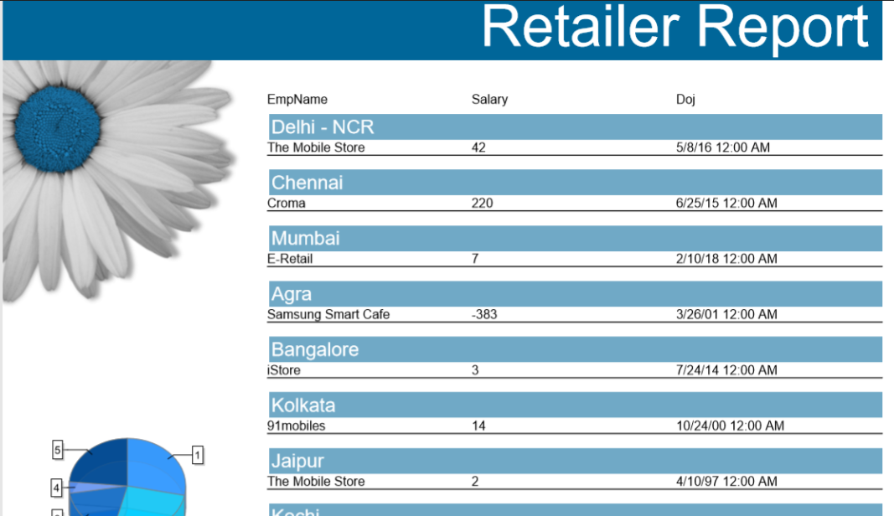

Slide 5
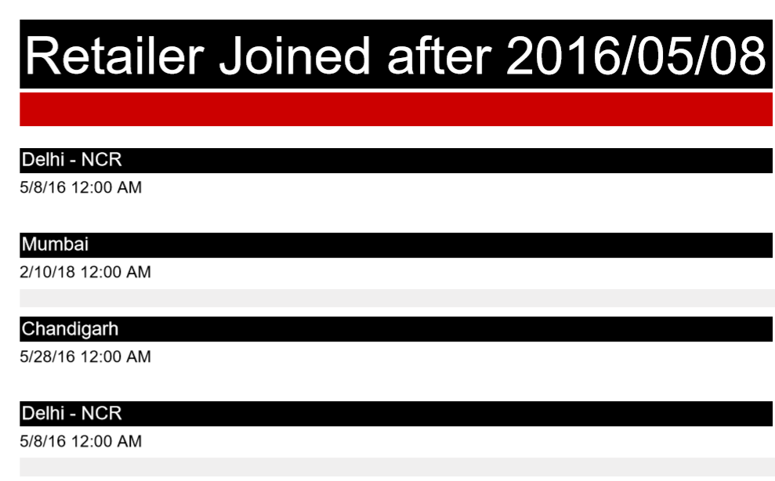

Slide 6
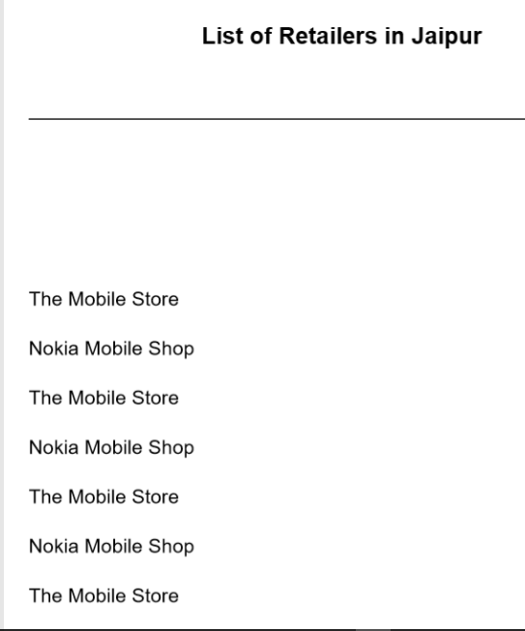

Slide 7
Work Done So Far…
Collection of Data.
The development of GUI .
Login/ Logout Functionality Implementation.
The username and password were verified using the data present in the database.
Generation of sample reports with Jaspersoft Studio.
Jasper API was then used to generate reports which was integrated with Java code.

Slide 8
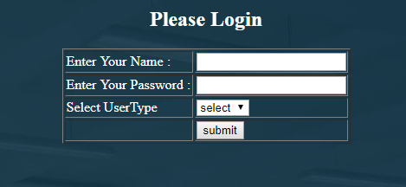
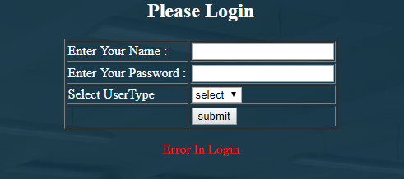
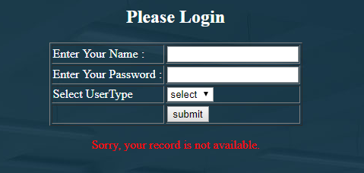
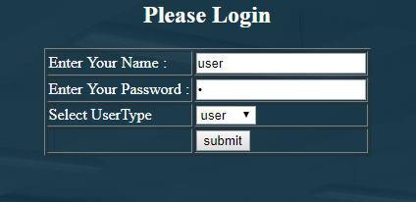

Slide 9
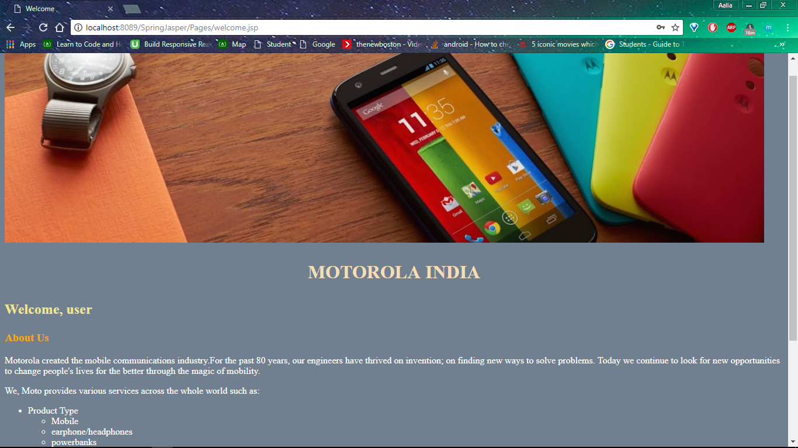
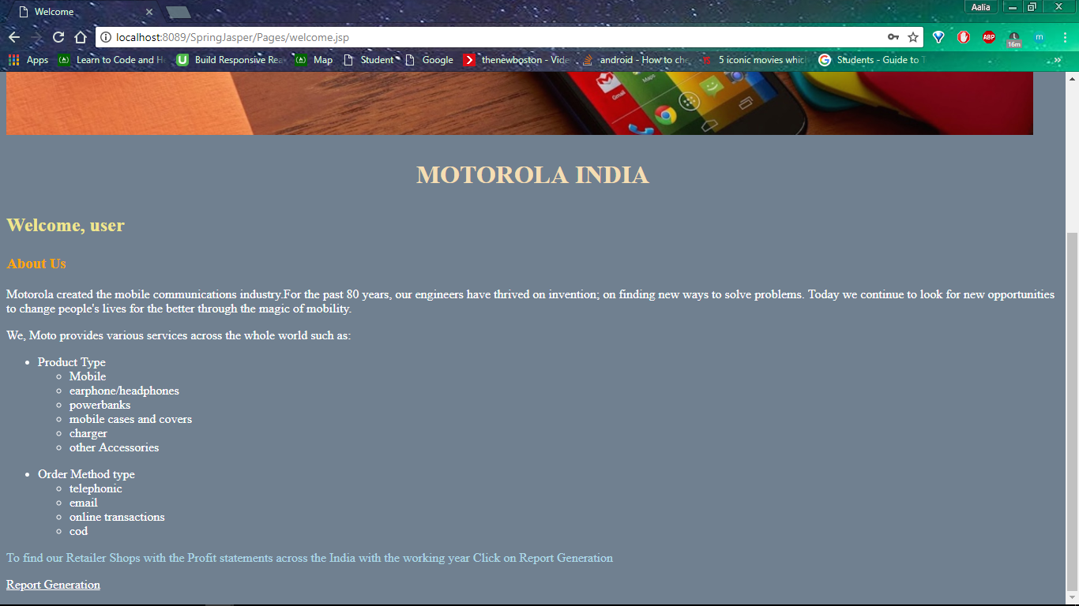

Slide 10
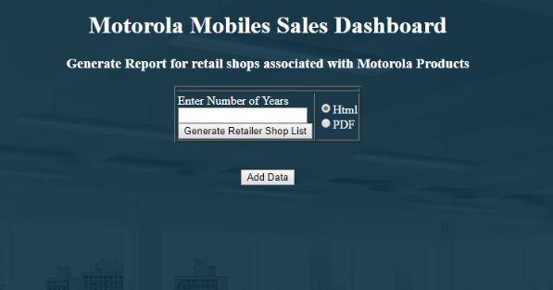
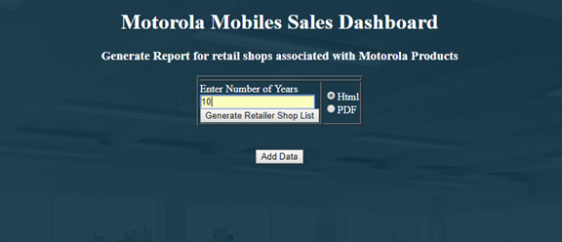

Slide 11
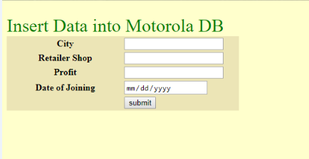
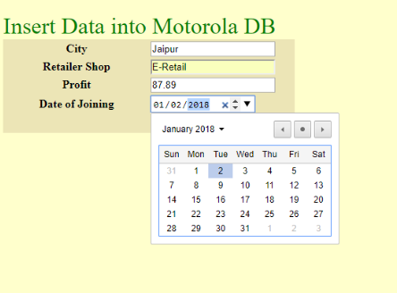
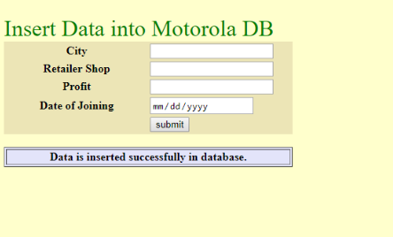

Slide 12
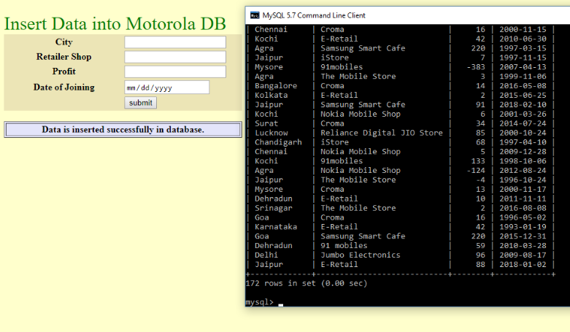

Slide 13
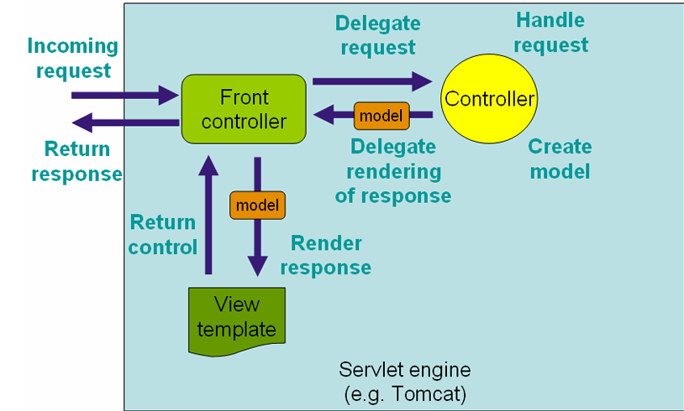
Spring MVC Framework

Slide 14
Roles & Responsibilities
Members | Responsibilities
Divya & Kashish | Dynamic Jasper Report generation using jasper API , Tomcat server Database Creation and Handling using MySQL and Excel sheet Login and Logout Functionality UI Design
Chinmaya | Implementing Dynamic query handling in Eclipse using Oracle DB, GlassFish Server ,Jasper API for Eclipse and JRXml file handling
Abhit & Abhishek | Generating reports using Jaspersoft Studio

Slide 15




Technologies Being Used
Eclipse Jee Oxygen
MySQL 5.7 Command Line Client
MySQL Workbench 6.3
Microsoft Excel
Tomcat 8.5
JasperSoft Studio API
Oracle DB 11g
Glassfish 4

Slide 16
Experiments and Results

Slide 17
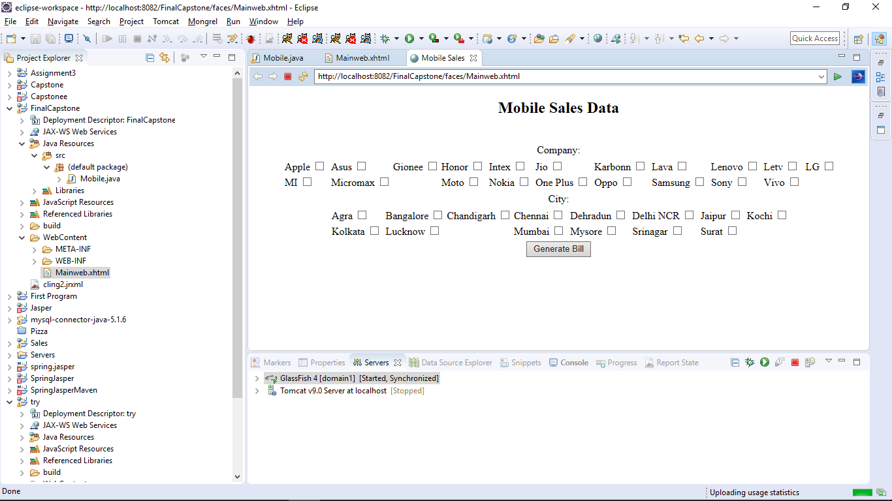

Slide 18
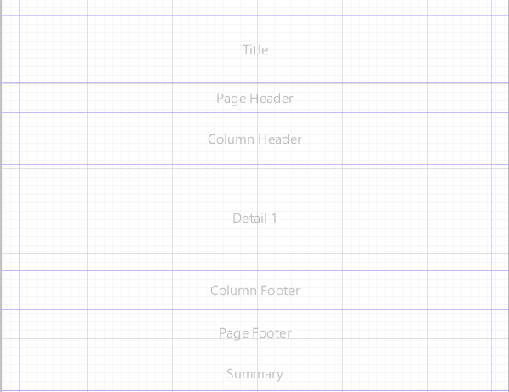

Slide 19
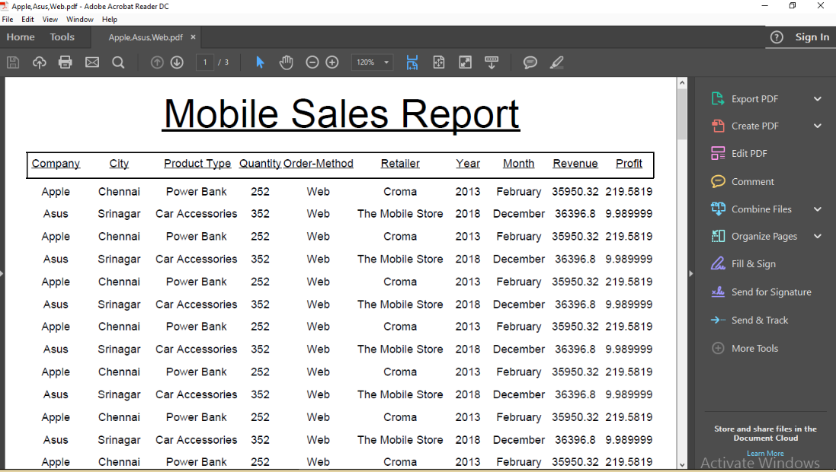

Slide 20
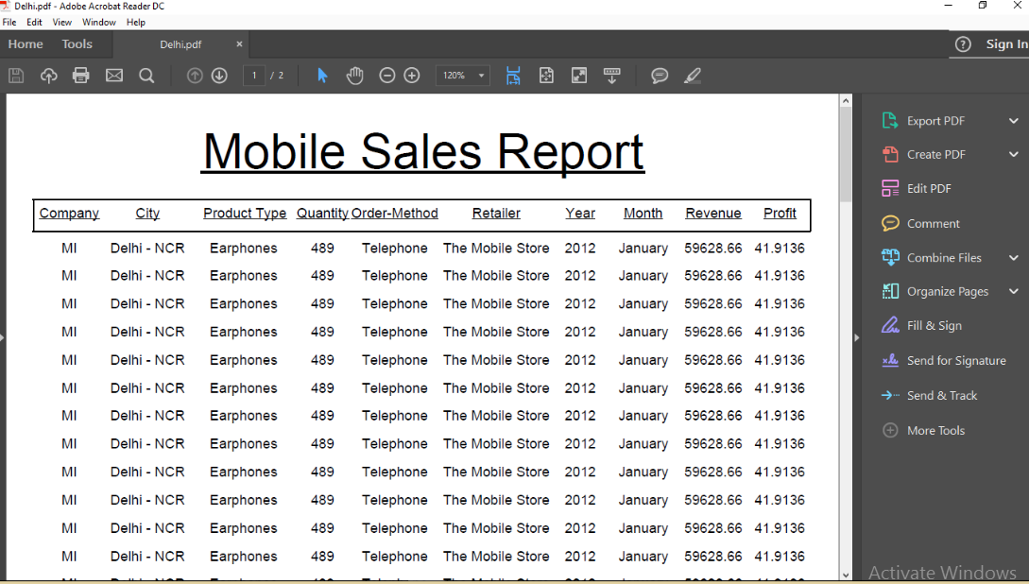

Slide 21
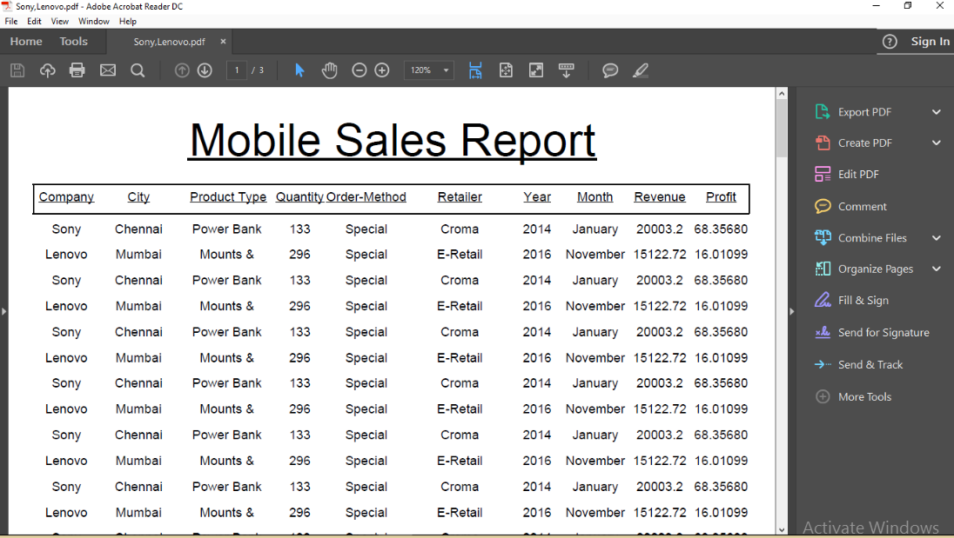

Slide 22
Any Work Left ?
Extra features to existing report:
Saving the document
Creation of one more template.
Showcasing reports in different formats like excel, doc etc.
Optional as per user’s choice
Header and Footer,
Page Number
Border

Slide 23
Thank You

